Slide 1
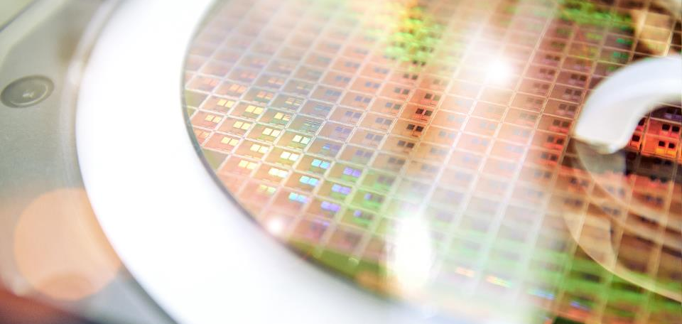
ALFA – LIMS System Training (Analytical Labs & Failure Analysis)
Daniel Garcia – ALFA Team
06/4/2025

Slide 2
ALFA LIMS System – Log-in & Account Request
LIMS link:
https://lims-sky.nova8.systems/login_form
Username: Infineon email (Example: daniel.garcia3@infineon.com)
Password: you will need to request new password
See instructions on Slide 3
New Account Requests:
Email: daniel.garcia3@infineon.com
Information needed:
Department name
Infineon email
LIMS Submissions:
Jobs reviewed & accepted by ALFA.
Job title & description is very important.
No more than 6 samples per job for imaging requests.
High priority jobs need manager’s approval.
Best contact information if need to review with requestor.
Need to know if anyone else needs to be copied on email when complete.
Specify sample priority order as a comment or in the description.

Slide 3
ALFA LIMS System – Password Request / Reset
New Password Request / Reset:
Email: Click on link and enter new password
Click Here
Enter your IFX email
Click Here
Click on Link
Enter New Password

Slide 4
ALFA LIMS System – Job Requirements
Title:
Imaging/FA: Include technology, device, lot, issue
Wet Chemistry: Include technology, chemical name & technique/tool.
Description: Identify type of analysis wanted, explain what you want to see, find, confirm or identify, location of cut and if measurements needed. If unsure of technique or analysis needed, contact ALFA team for advice via email.
Attachments: Documentation or ppt for specific defect site or area of interest including direction to perform FIB/TEM prep. CAD layout of layers for specific location and location of GDS file, if required to locate AOI.
KLARFF Files: Correct KLARF file uploaded including the location of the alignment marks used for the navigation.
Samples: Limit the number of samples per request if possible:
If more than 6 TEM and on different wafers, submit each wafer as a job
If 2 completely different techniques, submit as 1 job with samples for each technique.

Slide 5
ALFA LIMS System – Job Submission Process
Please DO NOT copy jobs unless you verify/update all information pertaining to new job including attaching documentation.
*
Ex. Chemical samples, wipes, gloves, etc.
Ex. Defects, profile checks, etc.
Ex. SIMS, VPD-ICPMS, XRD, Defects, et.c
To Create or Copy Job
*
*
*
Upload file / document to job – name of file cannot have special characters
*
*
High Priority Jobs need manager approval
*
*
Click on Submit button
Review information on next screen
Click on Create job button if everything ok

Slide 6
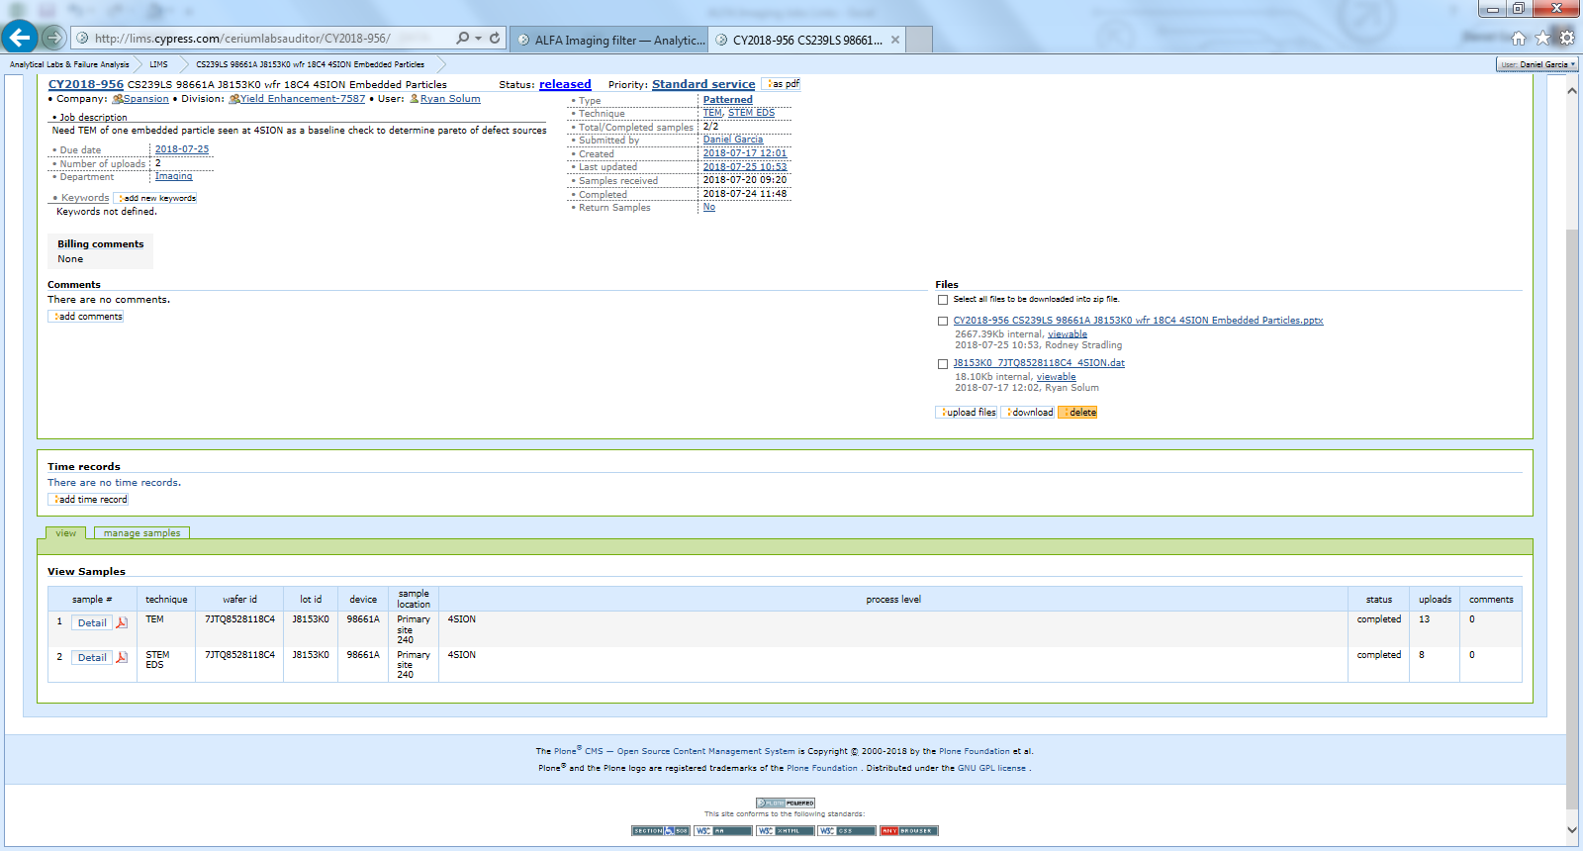
ALFA LIMS System – Example of Imaging Job
Click on PDF
Print form and deliver with your wafers/samples to B1 lab
Add any important information as a comment and make it viewable.

Slide 7
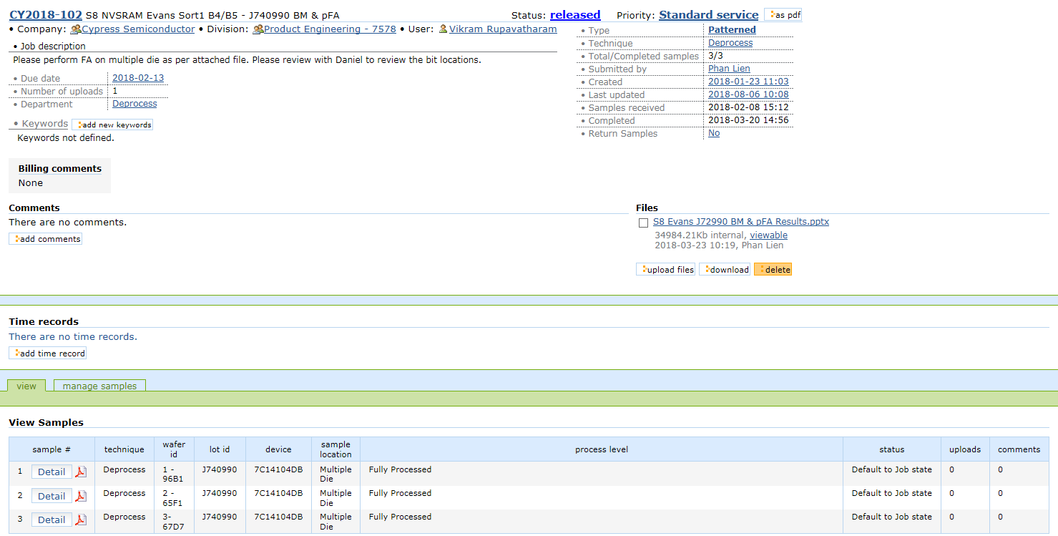
ALFA LIMS System – Example of PFA Jobs
Click on PDF
Print form and deliver with your wafers/samples to B1 lab
Add any important information as a comment and make it viewable.

Slide 8
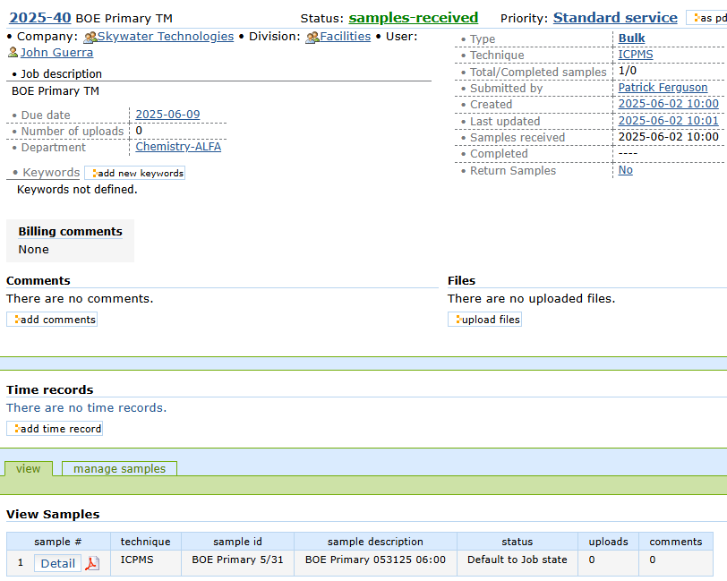
ALFA LIMS System – Example of Wet Chemistry Job
Click on PDF
Print form and deliver with your wafers/samples to B1 lab
Add any important information as a comment and make it viewable.

Slide 9
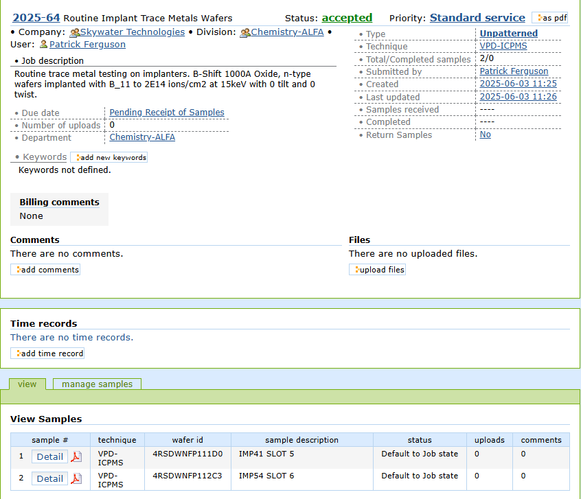
VPD-ICPMS Example
Tool name or department and short description of issue
Detailed information
Past jobs
Wafer history
Wafer id: Scribe number or last 4
Sample description: slot number, tool, oxide thickness.

Slide 10
Chemical Samples Example
Chemical name
Sample location
Lot number
Sample date
Excursion Information
Detailed information
Sample location, date/time, Lot number, tanker number
Sample id: Chemical name
Sample description: sample location, date/time, Lot number, tanker number, assay technique (pH, titration, %TS)

